Slide 1

24. VAAM Industry-Academia Panel
24.03.2026 at VAAM Annual Conference Berlin
„AI in Industry and Academia – Transforming Microbiology and Biotechnology“

Slide 2
Industry-Academia Panel @Annual Conferences 2023-2026
Göttingen 2023 „Microbiology based Spin-offs: Insights from the transition of an academic idea to a business concept“
Marcel Hövels, (Sweethoven Biotech), Luitpold Fried, (Bind-X), Jonas Ide, (Evonik Venture Capital GmbH)
Würzburg 2024 „From Lab to Market: Overcoming the Hurdles of Microbiological Start-Ups“
Khusal Borse (Plantilizer GmbH), Johannes Sonnenschein (Insempra GmbH), Nicole Wittenbrink (VDI/ VDE Innovation + Technik GmbH)
Bochum 2025 „Nagoya Protocol: Implications for Academia and Industry – Who is affected?“
Alexandra Lensch (Evonik Operations GmbH), Jörg Overmann (Leibniz-DSMZ), Kerstin Elbing (VBIO), Luitpold Fried (Bind-X), Alexander Probst (University Duisburg-Essen)
Berlin 2026 „AI in Industry and Acdemia – Transforming Microbiology and Biotechnology“
Aaron Weimann (University of Cambridge), Prateek Kumar Choudhary (Roche Diagnostics, Penzberg)

Slide 3
„AI in Industry and Academia – Transforming Microbiology and Biotechnology“

Slide 4
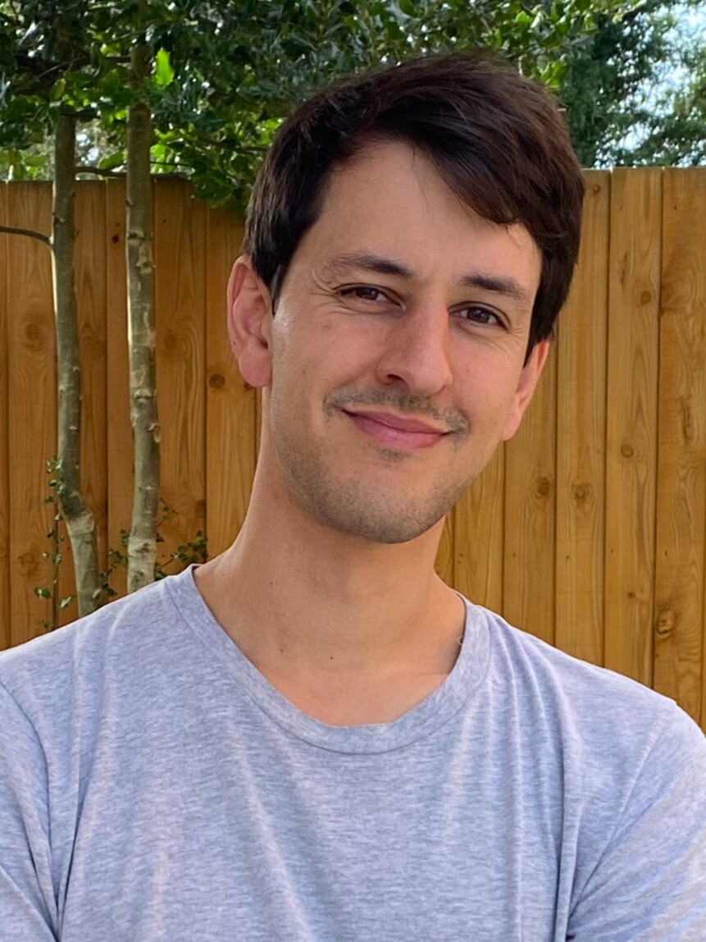
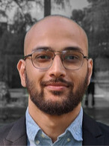
Aaron Weimann, University of Cambridge
"Leveraging AI to learn evolutionary patterns across bacteria"
Prateek Kumar Choudhary, Roche Diagnostics, Penzberg
"Accelerating Cell & Gene Therapy Development Through Artificial Intelligence at Roche“

Slide 5
Panel Discussion
Aaron Weimann
Prateek Kumar Choudhary
Stefan Pelzer
Jiri Snaidr

Slide 6
Save the Date
25. VAAM Industry-Academia Panel
21.05.2026, 4 pm, online

