Slide 1
25. VAAM Industry-Academia Panel
21.05.2026, 4 pm
„Process development – From lab to scale“
www.vaam.de

Slide 2
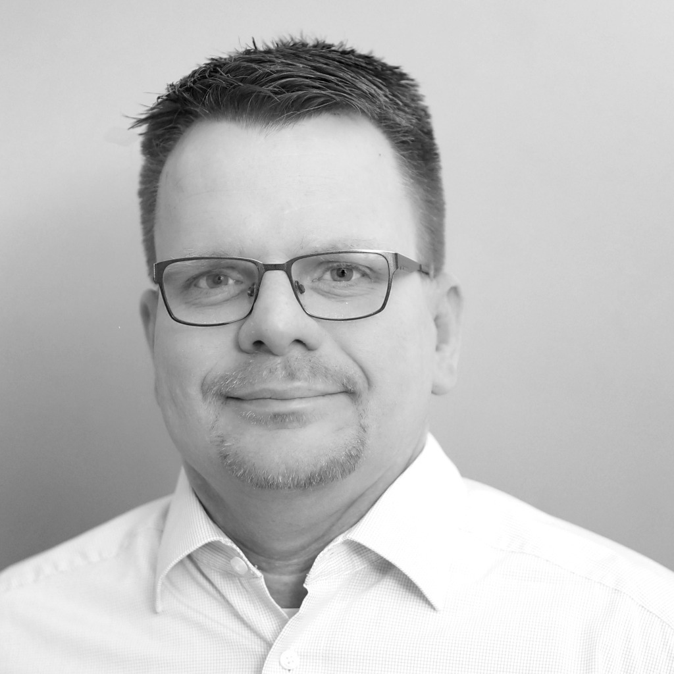
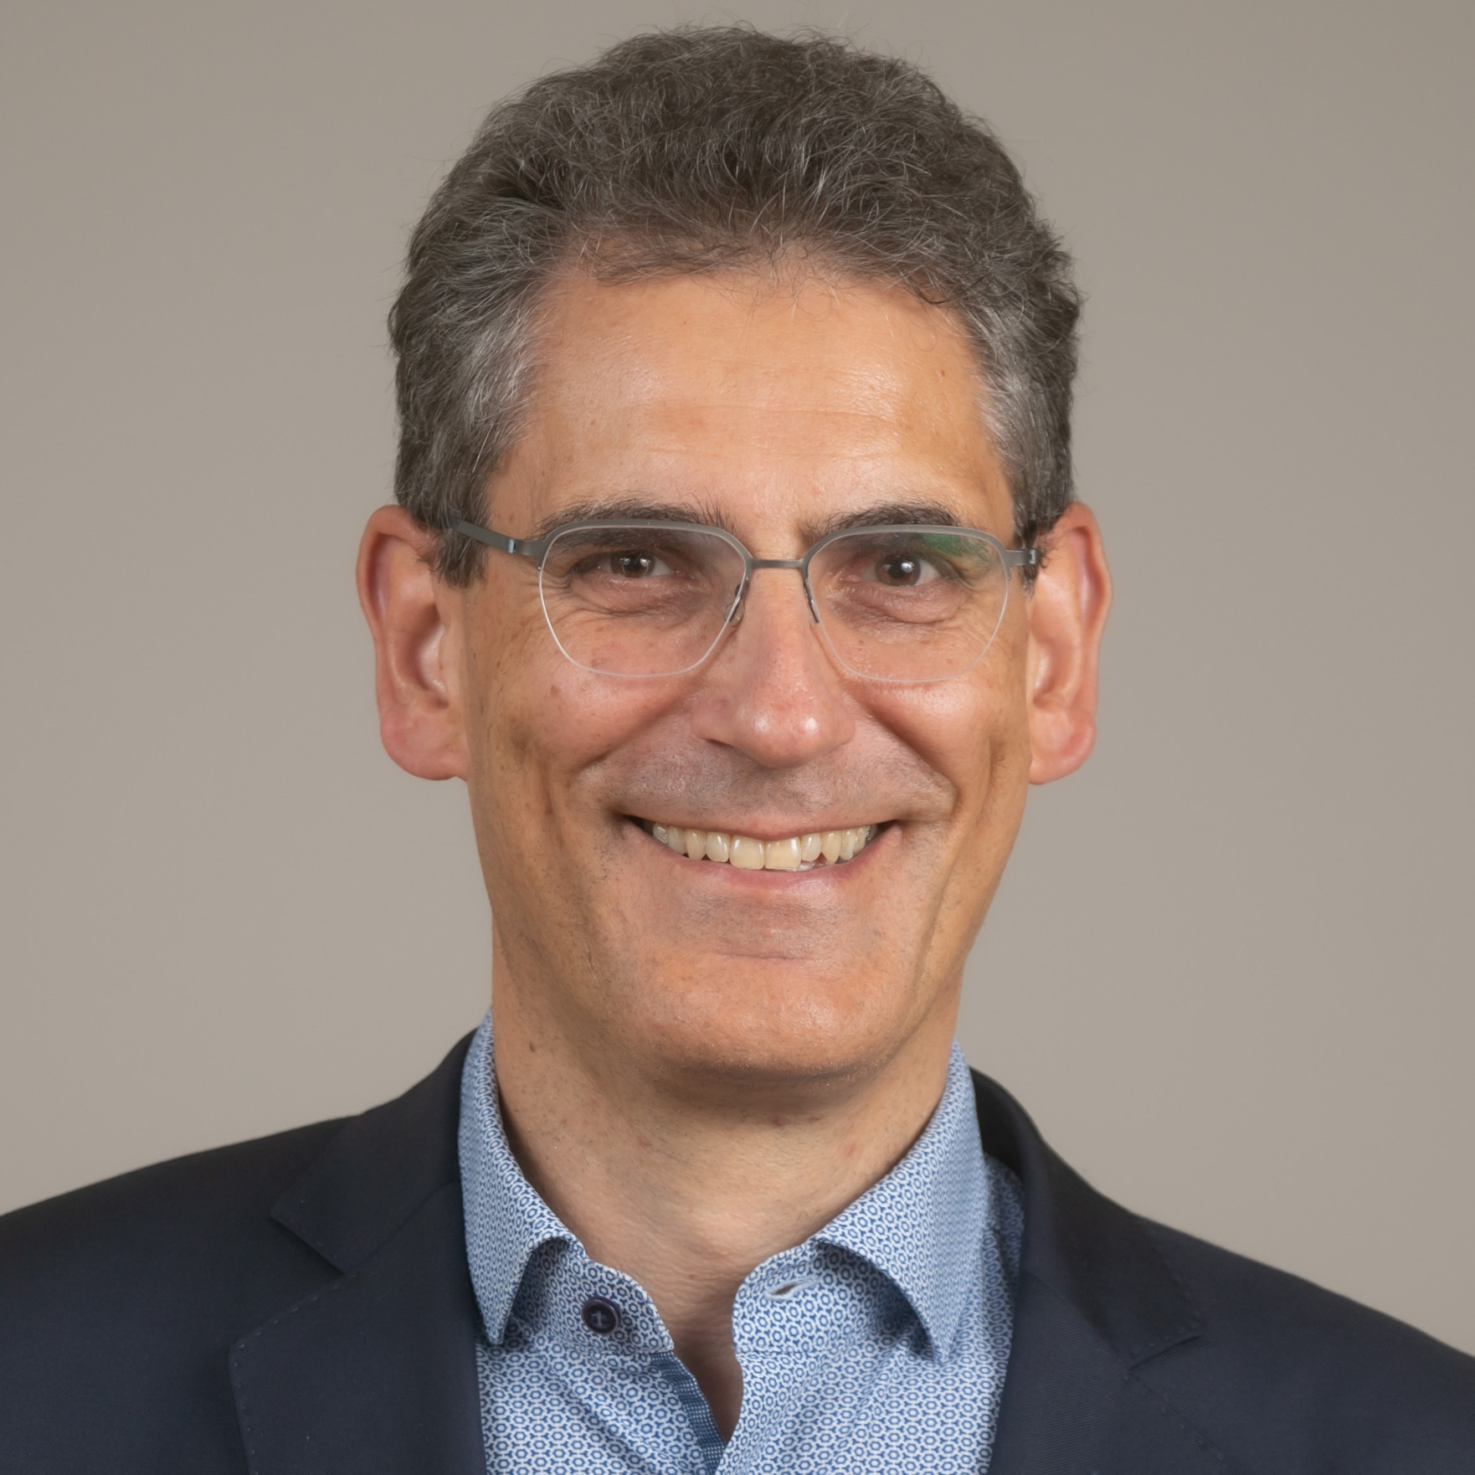
25. VAAM Industry-Academia Panel
Dr. Tobias Thiele
Corden BioChem, Berlin
„Practical Aspects of Scale-up and Technology Transfer"
Prof. Dr. Peter Neubauer
Technical University, Berlin
„Parallelized and Model-Assisted Bioprocess Development for Accelerated Scale-Up: The KIWI Biolab Approach”
www.vaam.de

Slide 3


Microbiology connects — join VAAM
Reduced Fees
Save on VAAM Annual Conference, Special Group Symposia, and GBM or DGHM events.
Young Scientists
Travel grants, PhD Awards, and the VAAMentoring programme support your career.
Connect
Join our Special Groups or the Young Scientist Network and grow your community.
Stay Informed
7 issues of BIOspektrum per year plus access to current science and news.
And many more benefits — www.vaam.de/membership

Slide 4

Save the Date
26. VAAM Industry-Academia Panel
Thursday, 16.07.2026, 4 pm
www.vaam.de

